Slide 1
The Village at Shirlington

Slide 2
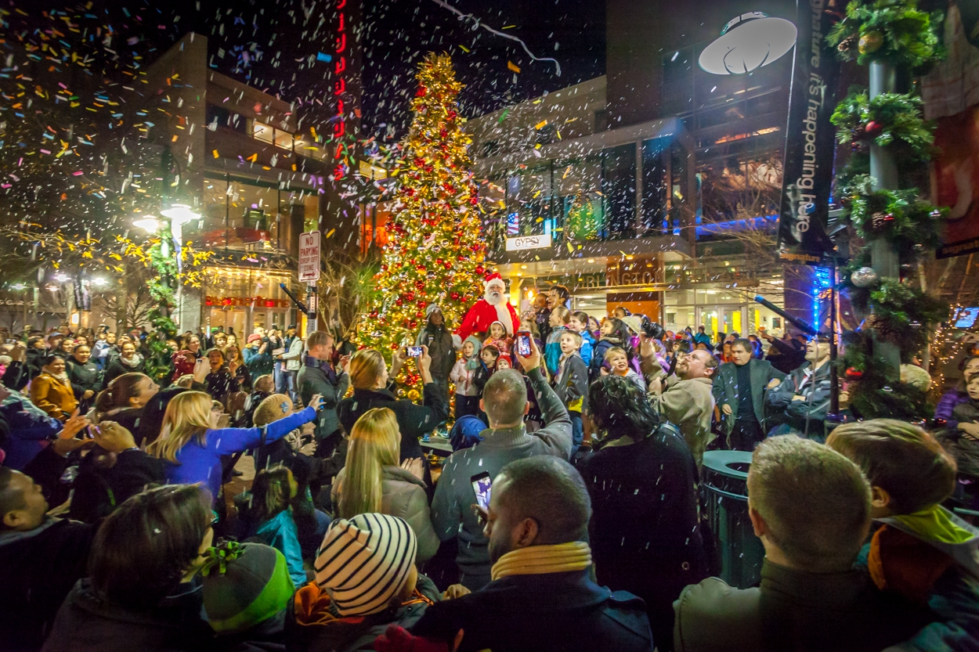
Introductions
Mickey Papillon – Director, Asset Management, Mixed Use Division
Norma Selman – Regional Property Manager, Mixed Use Division

Slide 3
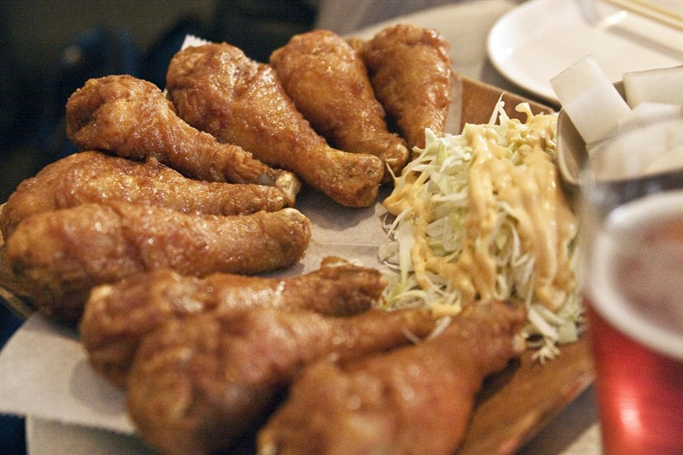
new in the village – Dak chicken
Modern Korean fusion restaurant
Korean style soy garlic, spicy, or honey glazed chicken, along with a variety of Korean style fusion food and unique Korean drinks
Opened in August in the former Bonsai space on Campbell Ave

Slide 4

new in the village – hula girl
Born from food truck favorite, Hula Girl Truck
Familiar plate lunches and Spam musubi mixed with chef-driven dishes
Full bar with Hawaiian drinks and beers
Under construction, with a planned Q4 opening in the former Alladin’s Eatery space on Campbell Ave

Slide 5
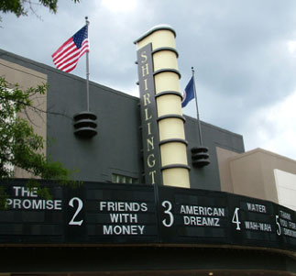
new in the village – amc theater
Complete interior renovation including reclining seats
All seven theaters will be done
Construction underway with a scheduled completion and reopening in late November

Slide 6

new in the village - Palette 22
Palette 22 will combine art with food, focusing on modern international street food small plates
Local art and artists will be integrated into the experience
Under construction, with an opening scheduled for mid-January in the former Extra Virgin space on Campbell Ave

Slide 7

new in the village - Dudley’s Sport & Ale
12,000 SF sports bar
The first establishment to have rooftop space in Shirlington
Opening scheduled for Q2 2016 in the former Bungalow Sports Grill space off South Randolph Street

Slide 8
new in the village - Dudley’s Sport & Ale

Slide 9
new in the village - Dudley’s Sport & Ale

Slide 10
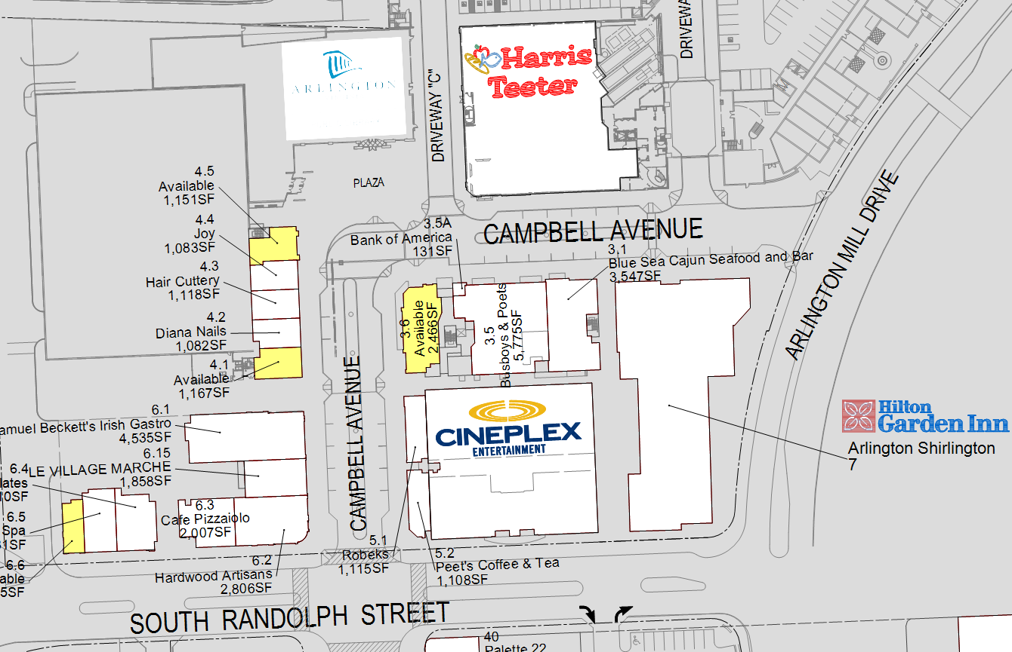
Future village opportunities
Former Johnny Rockets
3 small retail spaces available in the Randolph Square building

Slide 11
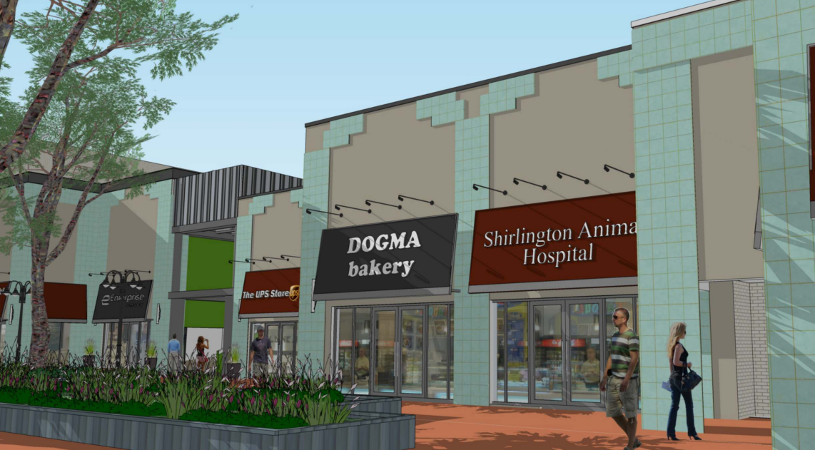
2016 proposed property upgrades
North side improvements:
New retail storefront awnings
New storefront tile
Planter area enhancements

Slide 12
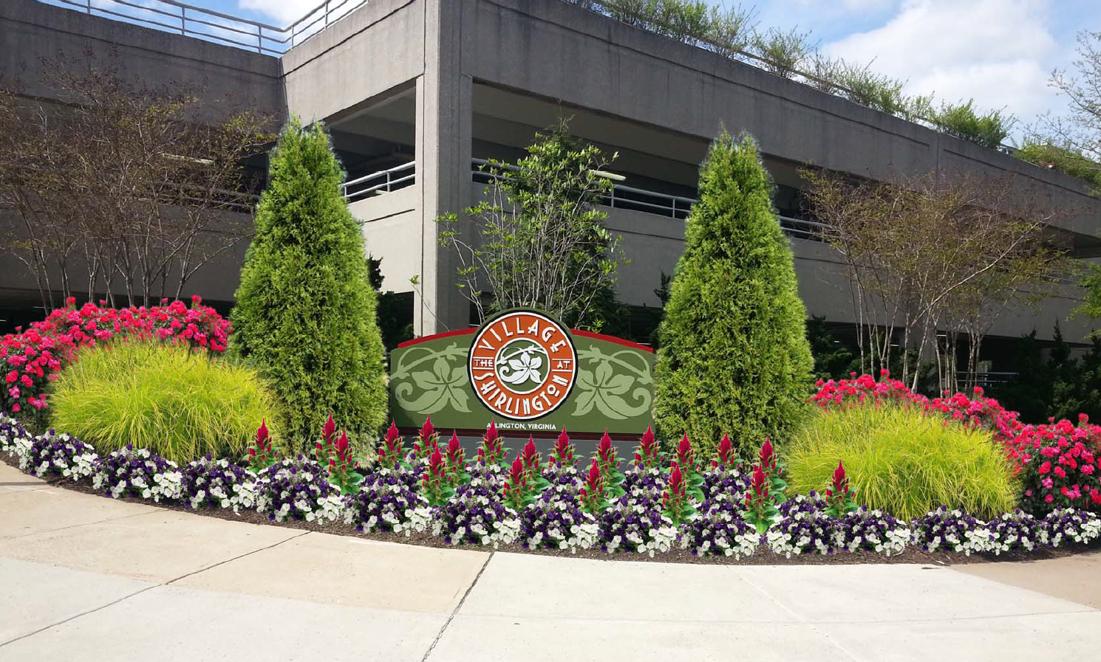
2016 proposed property upgrades
Landscaping improvements:
Prune and trim mature trees
Revitalize pots and courtyard beds throughout the property with seasonal color
Refresh entrance medians on Campbell Street and S. Randolph Street

Slide 13
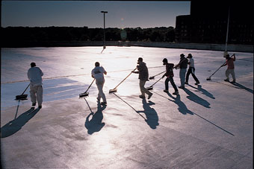
2016 proposed property upgrades
Parking garage maintenance:
A comprehensive maintenance program is key to preventing future garage failures
Following successful projects in 2015 at Pentagon Row and Bethesda Row, a similar multi-step system is being implemented in Shirlington in 2016 on the Campbell Ave garage

Slide 14
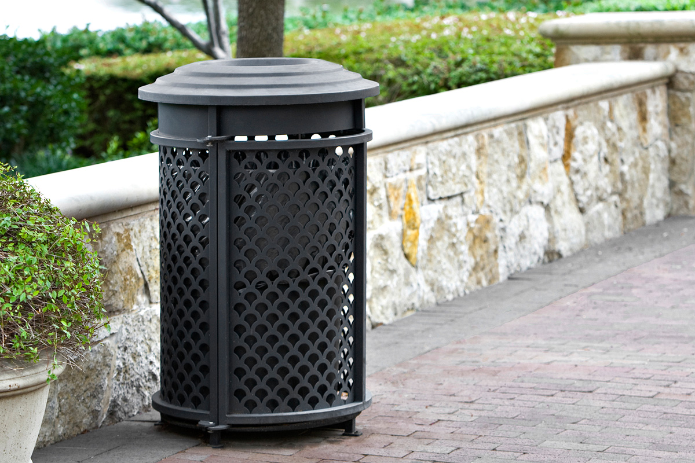
2016 proposed property upgrades
New trash and recycling containers:
Coming early 2016

Slide 15
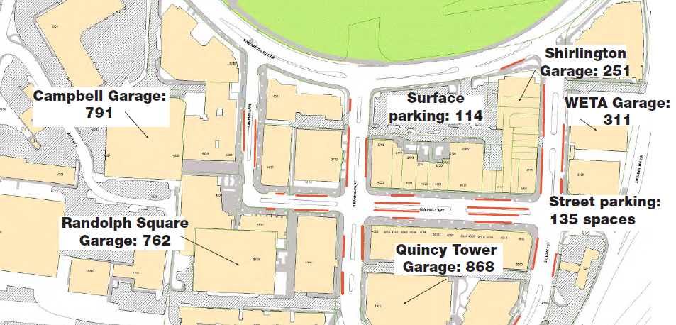
Village Parking – 2,921 Total spaces

Slide 16
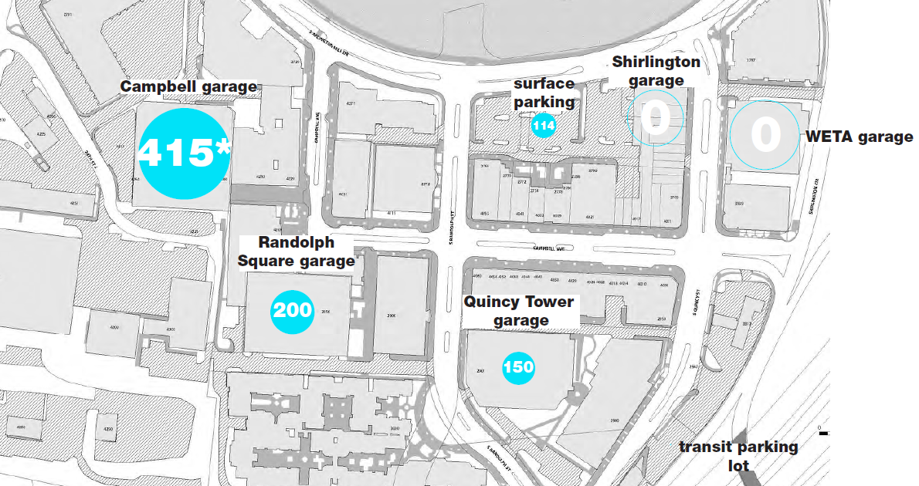
Village parking – Weekday Daytime

Slide 17
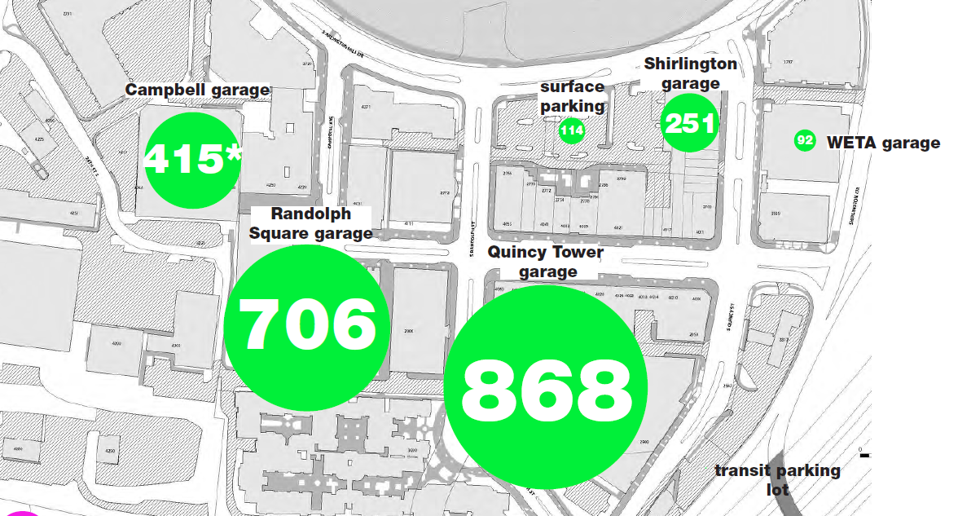
Village parking – Evening/Weekend

Slide 18
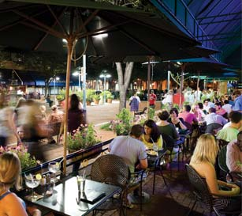
Upcoming events
Light up the Village – December 1 at 6p
  Our community tree lighting, featuring a special 30 minute holiday performance by Signature Theatre, live music, photos with Santa, horse and carriage rides, snowman photo booth, strolling entertainment, merchant open house specials and tastings and more.

Slide 19
Federal Realty property contact information
Ralph Ours – Retail Leasing Opportunities – 301-998-8154 | rours@federalrealty.com
Jill Powell – Marketing/Event Information – 301-998-8178 | jpowell@federalrealty.com
Jacqueline Keenan – Marketing Coordinator – 301-998-8288 | jkeenan@federalrealty.com
Mickey Papillon – Director of Asset Management – 301-998-8120 | mpapillon@federalrealty.com
Norma Selman – Regional Property Manager – 301-998-8215 | nselman@federalrealty.com
Village at Shirlington Security – 703-350-9129
Colliers Service Center (site issues/concerns) – 888-389-9932
*Please remember that items inside of a merchant space will have to be discussed with the specific merchant*

Slide 20
The Village at Shirlington

